Slide 1
Object Detection + Image Captioning + Text2Speech
Machine Learning – Project 3 Group 6 team members: Mauro Travieso Pena Quoc Huy Luong Ngoc Bao Tran

Slide 2
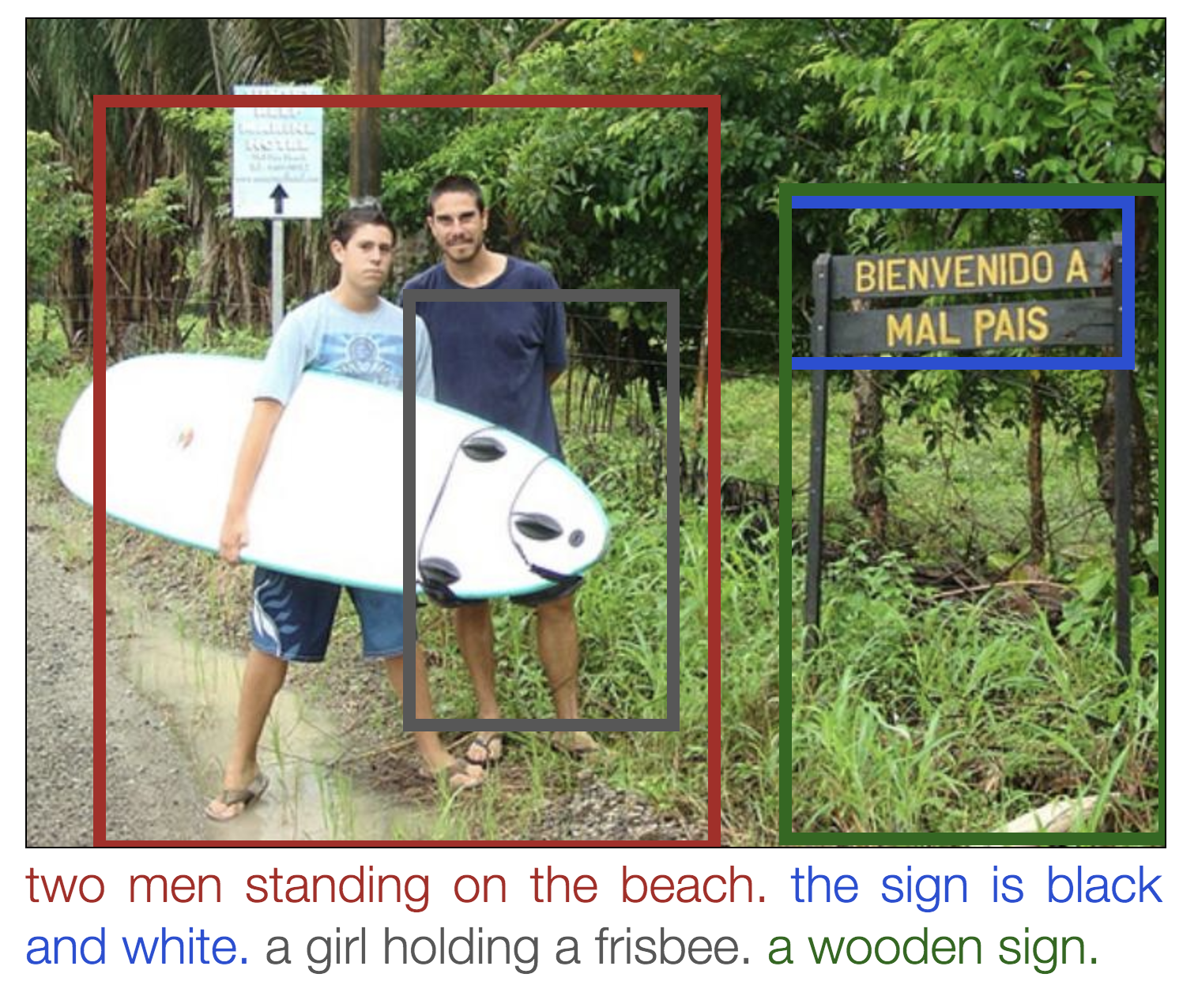

Object Detection + Image Captioning + Text2Speech

Slide 3
Object Detection + Image Captioning + Text2Speech
Why to combine Object Detection with Image Captioning ?
Object detection returns the list of objects, for example:
- 3 persons, 2 dogs, 2 cars and road
- The location of objects
Image captioning returns about the caption of the image, for example:
- A group of people is walking on the road
Combine two results we will have the meaningful of the image, for example
- Two persons are walking with 2 dogs on the left side of the road
- One person is walking on the right side of the road
- And One car is on the road (running or parking)

Slide 4
Object Detection + Image Captioning + Text2Speech
Why Text2Speech ?
To help visual impairment person to know about objects around
Can apply translation of the caption of the image into any languages, then apply Text2Speech
With RGB-D image (future): we can train model to tell us about the depth of each objects
Image original caption
Image translated caption
(Spanish)
Image translated caption
(Vietnamese)

Slide 5

Running Environment colab.research.google.com Runtime type: Python3 Google Compute Engine Backend Hardware accelerator: GPU

Slide 6
Object Detection Model (YOLO V3)

Slide 7
Object Detection YOLOv3
Hyper parameter | Value
Batch normalization epsilon | 0.001
Leaky-ReLU: alpha | 0.1
Model size | 460 x 460
Anchors (width, height) | Scale3: [[116,90, 156,198, 373,326],
 | Scale2: [30,61, 62,45, 59,119],
 | Scale1: [10,13, 16,30, 33,23]]
Object Detection Threshold | 0.6
Non-max suppression IOU | 0.5
Model weights | yolo3.weights
https://pjreddie.com/media/files/papers/YOLOv3.pdf

Slide 8
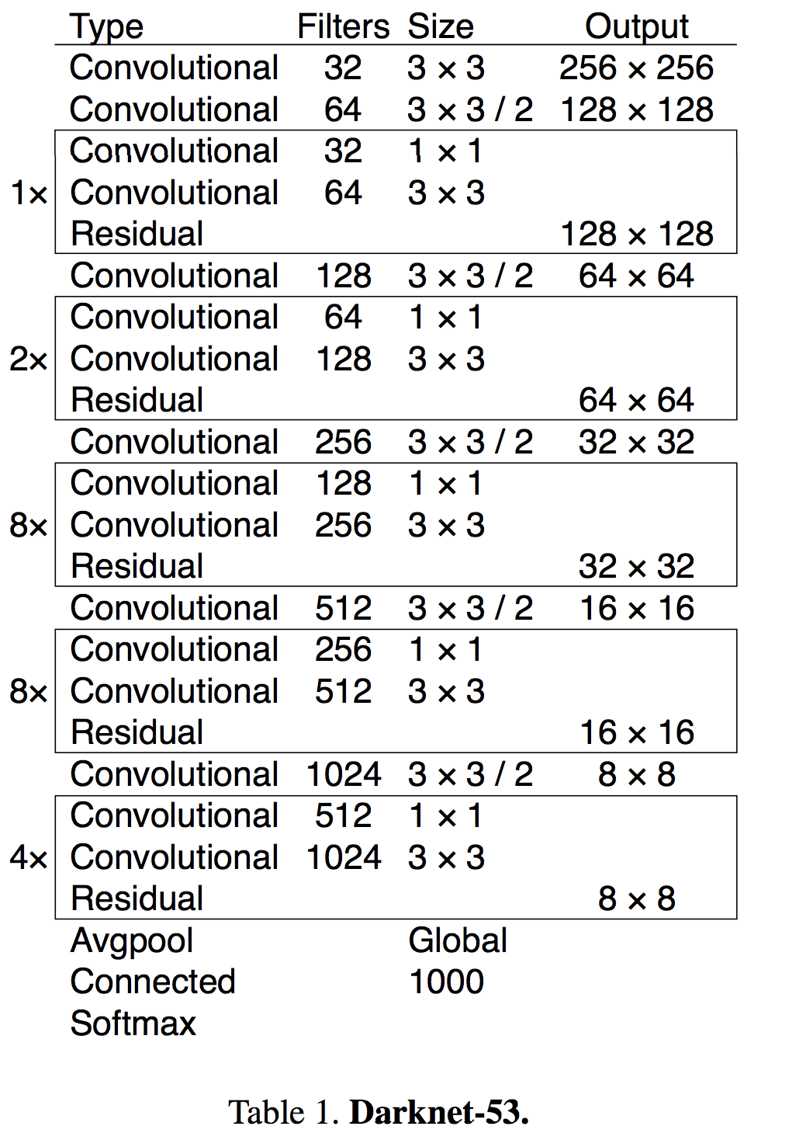
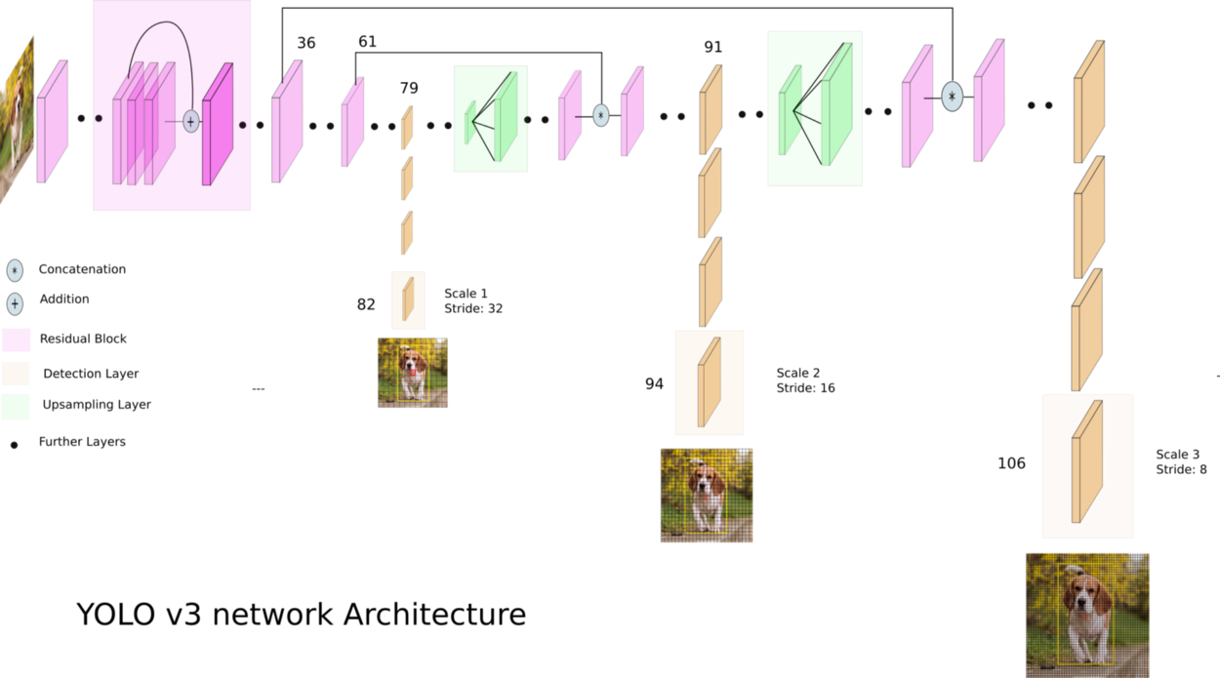
Object Detection YOLOv3
https://towardsdatascience.com/yolo-v3-object-detection-53fb7d3bfe6b

Slide 9
Image Captioning (CNN-LSTM)

Slide 10
Image Captioning
Keras With Tensorflow back-end
InceptionV3 for encoding – transfer learning
LSTM for decoding
Greedy as well as Beam search was used.

Slide 11
Image Captioning Hyper Parameters
Hyper parameter | Value
Embedding size | 300
Vocabulary size | 8256
Dropout | 0.5
Batch Size | 128
LSTM 1 Output | 256
LSTM 2 Output | 1000
Epoch | 10
Model weights | Inceptionv3 weights

Slide 12
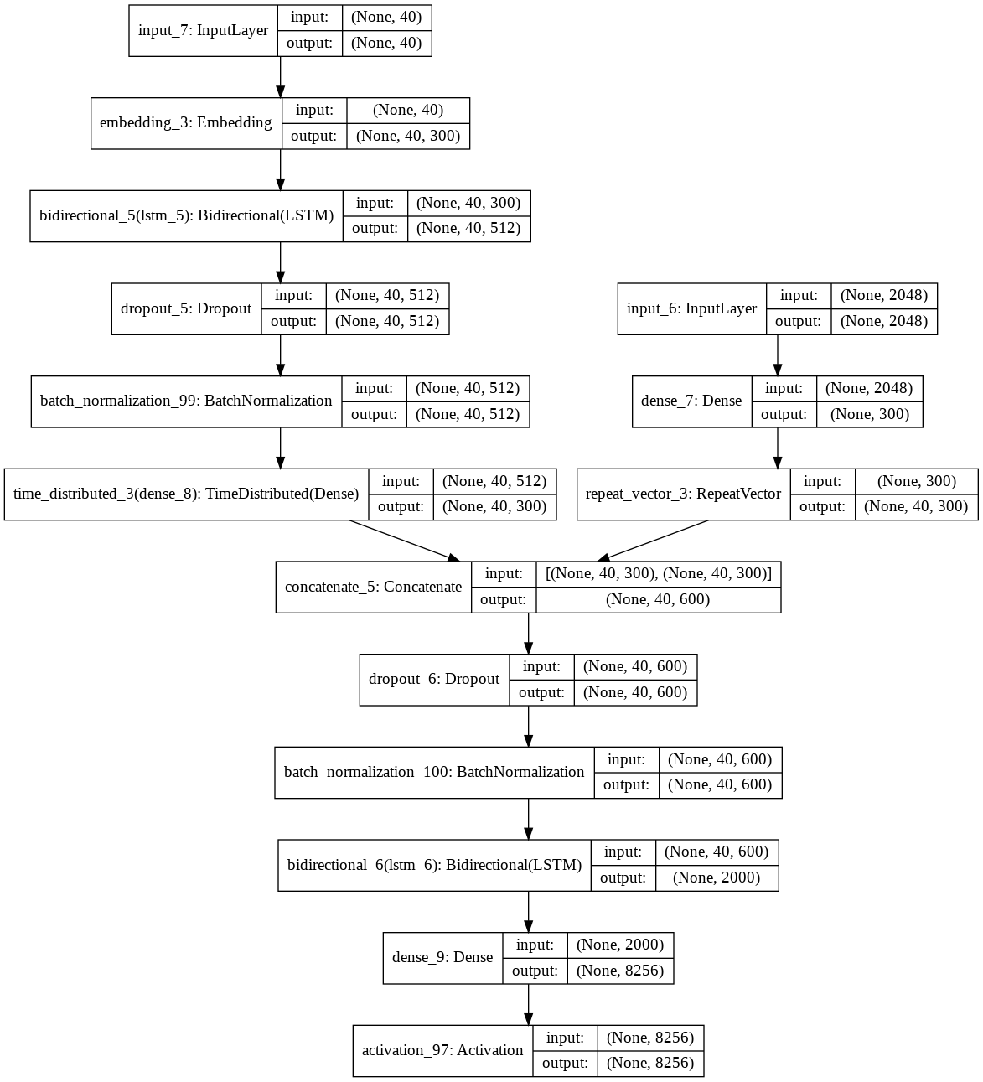
Image Captioning Model

Slide 13
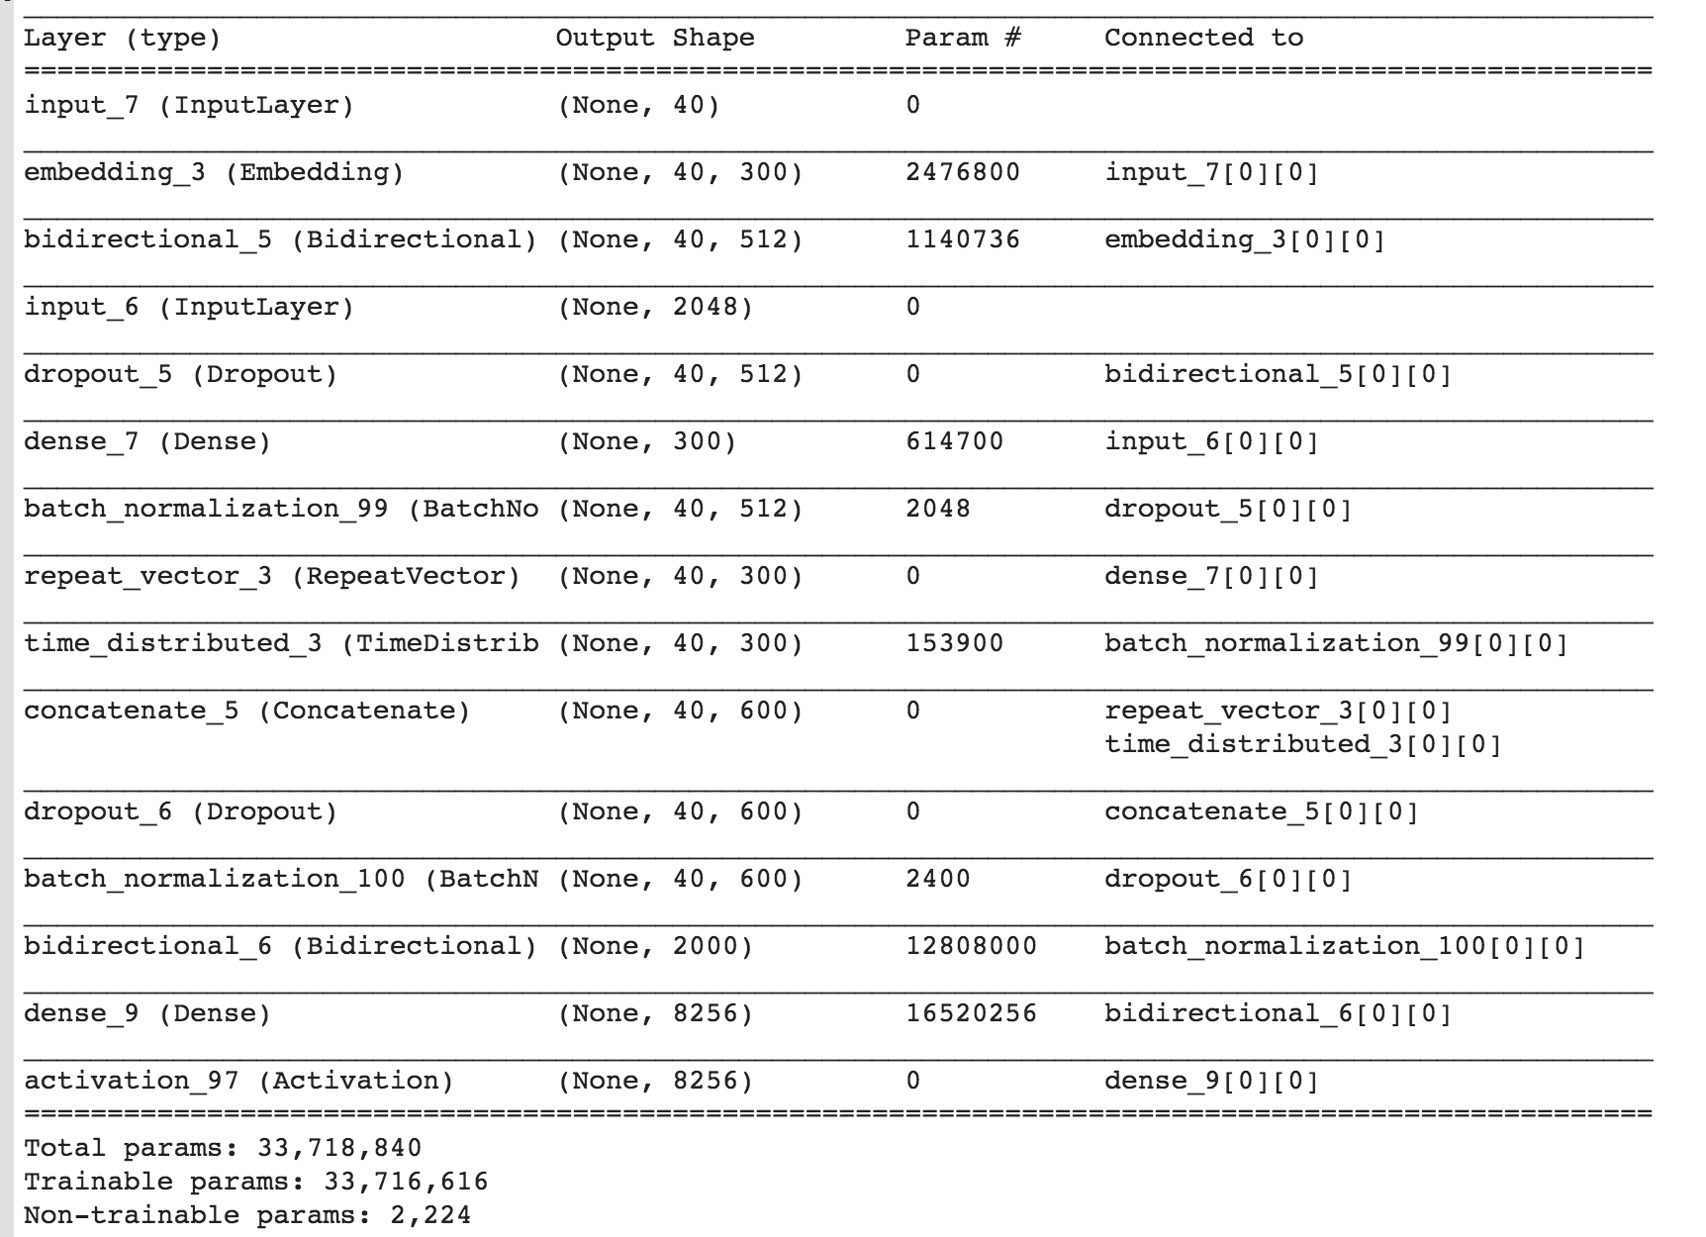
Image Captioning Layers

Slide 14
Text2Speech
(Google Text to Speech (TTS) API)

Slide 15
Text2Speech
Pyttsx text to speech
Cross-platform text-to-speech wrapper.
It uses different speech engines based on the operating system.

Slide 16
Text2Speech
gTTS text to speech
gTTS is a module and command line utility to save spoken text to mp3.
It uses the Google Text to Speech (TTS) API.
https://pythonprogramminglanguage.com/text-to-speech/

Slide 17
Thanks
(Questions?)

